Slide 1
Company profile Good&Services Glories&Honors
Sincerity ， Unity ， Creation ，Win-win

Slide 2
01 02 ⁰³
Company Profile
Goods& Service
Glories& Honors

Slide 3
01
Company Profile
l Overview l Certifications&Honors l Development l Structure

Slide 4
In 2001, Tina Hong Paper Printing Limited Comany was founded in Dongguan, Guangdong,China, the world’s largest manufacturing hub. We have a general investment of more than 200 million RMB, a plant area of more than 15,000
square meters, and a total amount of approximately 260 employees.
As a professional OEM printing manufacturer, quality print and timely delivery is our motto. In the past twenty-one
years, we are fully committed to providing high-quality custom printing services, and have assisted our clients with cost-effective solutions and product developments. In the meanwhile, we have implemented reliable quality
management systems that adhere strictly to international standards.
As we also possess certificates from ISO9001, ISO14000, FSC, Disney, NBCUniversity, and Sedex, as well as advanced equipment, including ROLAND and Heide berg printing presses, automatic die-cutting machines, omnipotence folding paper machines, and automatic binding machines, we believe we could provide qualified Goods&Services at highly
competitive prices for our clients.

Slide 6
2004
Passed the IS9001:2000 quality
management system and ISO14000 environmental management system certification.
2021
NBCUniversity Certification.
2017
Disney FAMA.
2019
Certified by Wallmart.
2022
Equipped with Heidelberg XL106-8-P+L18K Eight-color printing press.
2001
Established Dongguan
Chaodong Paper Products
Printing Factory, then renamed to Tina Hong Paper Printing
Limited Comany in 2014.
2016
BSCI Certifiction.
2018
FSC Certification.
2020
Adopted CJS printing color
printing management system.

Slide 7
Printing &Packing
Souring
R&D
OEM
covers multiple functions from designing,
typesetting, printing, and binding of kinds of
products, such as books, magazines, gift boxes, catalogs, label, etc.
helps our clients locate down local suppliers, and focuses efforts on analyzing supplier list and
performance and pay more attention to the risk potential of each supplier.
mainly responsible for the research and
development, and improvements of our clients’ printing and packaging solutions.
identifies our clients’ needs in printing&packing customizations, and accordingly, passes the
messages to our production team.

Slide 8
02
Goods& Services
l Main Products l Our Pros l Services l Overseas Marketing

Slide 9
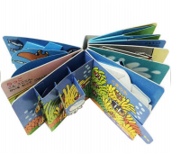
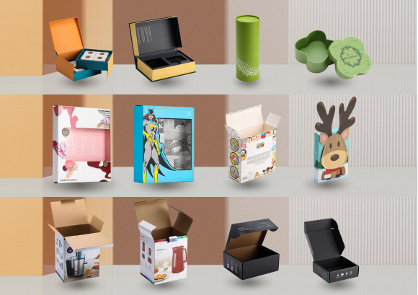
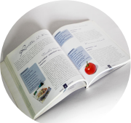
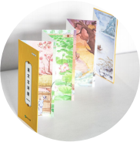
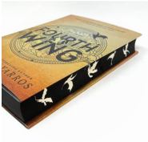
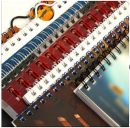
1. Gift box and corrugated box supplier of leading Consumer Electronics&Home Appliances brands, such as Sony, Philips, KENDWOOD, K itchAids, Theragun, etc.
2. Collaborating with overseas
publications and individual publishers: non-fiction books, children books, magazines, and stickers, etc.
3. Besides, our other highlighter products also including kinds of notebooks,
brouchers, manuals, and catalogs, etc.

Slide 10
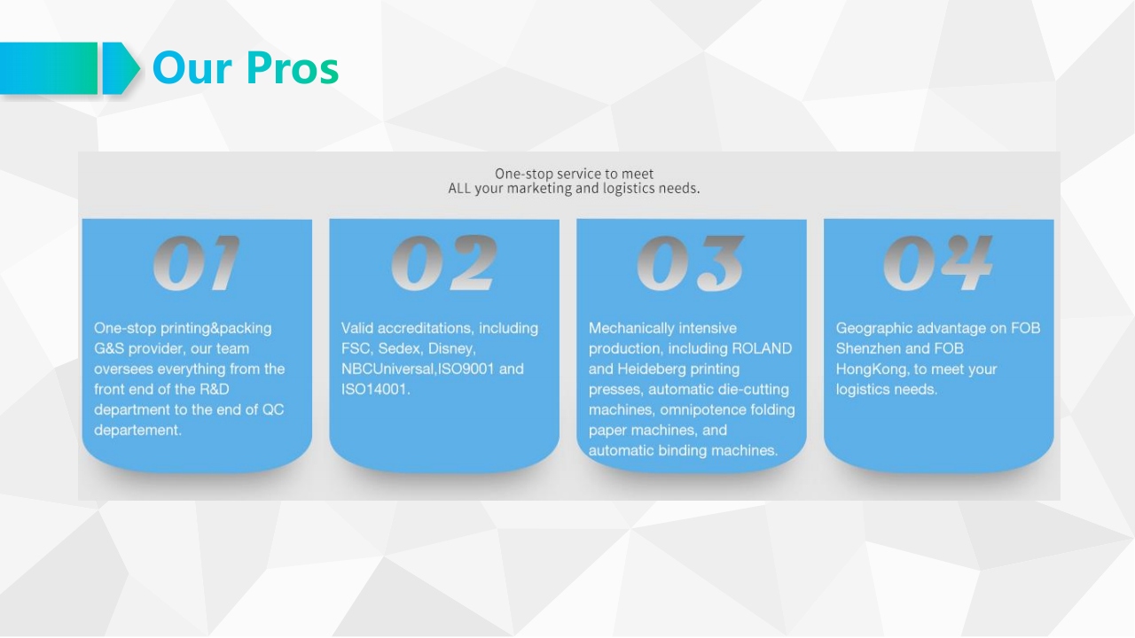

Slide 11
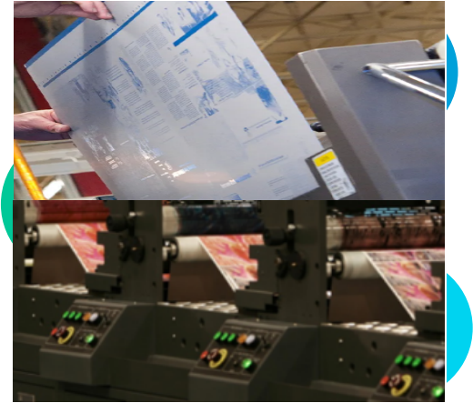
2.
Computer-to-plate and laptop-to-press generation helps in decreasing cost, offering
higher consistency, decorating productiveness, best, and decreasing the threat of human errors. The plates are developed from a selection of
substances starting from aluminum to polymer.
1.
Empowered with our CTP
(Computer-to-plate), which is an imaging technology used in modern
printing processes. In this technology, an image created in a Desktop Publishing
application is output directly to a printing plate.
CTP ensures reliable and efficient
production in all format classes –
regardless of whether the client need
automation, flexibility, or simple operation.
3.
Industry 4.0 intelligent digital
workshop, to achieve intelligent scheduling → self-reporting → online process → total
quality → production traceability → electronic signage → real-time call → equipment
monitoring → control integration → finished product shipment and other series of lean
intelligent factory.

Slide 13
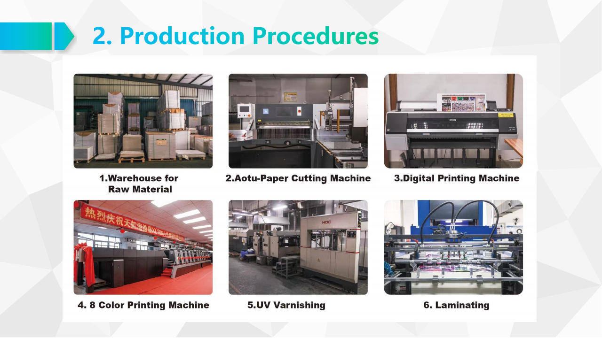

Slide 16
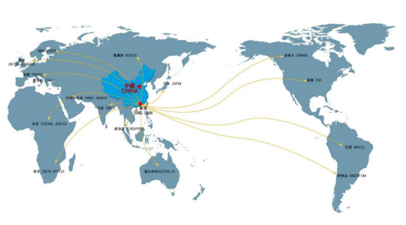
Our marketing
network covers Asia, Europe and North
America, with the
ultimate purpose to expand local markets as well as to serve
more customers.
Asia
30% 10%
UK
Europe
40%
20%
North America

Slide 18
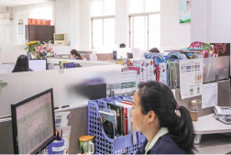
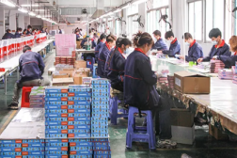
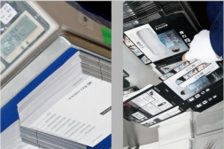
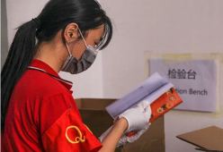
Pre-Sales Service
We provide professional advice and suggestions according to
customers' requirements and provide complete solutions for free. Our business and engineering staff communicate fully with customers at the early stage of the process to understand their needs.
In-Sales Service
At every stage of product design and production, we communicate with customers to provide timely feedback and to address any
temporary problems or changes needed by customers.
After-Sales Service
Once the products are delivered to customers, organize the business and the relevant persons in charge to return to them, to understand the situation related to the product, to deal with relevant issues as
soon as possible, and to provide support and assistance to customers.

Slide 19
03
Core Values
l Company Culture l Company Philosophy l Milestones l Partnerships

Slide 20
^{Technique} ^{Innovation} _{Evolution}^{Development}
Quality ^{Authencity}
The service tenet we follow is to "treat customers with respect, to treat each other with sincerity, to build a
foundation of faith, and to win with quality", and to constantly innovate in order to be able to provide
customers with quality products and fast, high-quality service with value-added products.

Slide 21
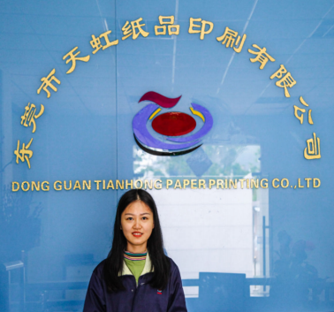
01
02
03
04
Sincerity ， Unity ，Creation ，Win-win
We strive to achieve social harmony by empowering our employees, creating value for our clients.
Dedicated to cultivating first-class employees and providing high-quality printing.
To become a leading printing and packaging innovator in China.

Slide 22
Services
Quality
Techniques
Service must be provided, quality must be
maintained, and technology must be developed.
Innovation
Evolution
Development
Innovation, passion, commitment to the future.
Since 2022, we had been adopted to use the soy bean ink. As we had been informed of a new French law which prohibits
the use of mineral oils in printing inks (the French law for reference
is ‘ Law 2020-105 on the Fight Against Waste and the Circular Economy’).

Slide 24
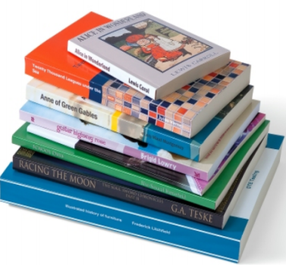
2016
2017
2019
2020
2021

