Slide 1



NE_Build & Grow
ELT Specialist Brand
With over 40 years of English educational know-how

Slide 2

▶Who We Are
NE Neungyule started as a English reference book publishing company in 1980.
We expanded our business into new fields such as English textbooks, ELT, corporate education, and math.
By merging with i-challenge, we are advancing as a comprehensive education service company catering to people of all ages, from infants to adults.
▶Our History
Neungyule Education, an English educational publisher, launches
Publishes the Neungyule VOCA and Reading Tutor series that have become bestsellers in Korea
-Launches ELT brand NE_Build & Grow
-Begins publishing middle school English textbooks
1980
1983
1990
2008
-Begins publishing high school English textbooks
-Listed on the KOSDAQ
2002
Becomes the official distributor of Oxford University Press in Korea
2015
2017
-Merges with i-challenge, an integrated development program for infants and toddlers
-Changes the company’s official name to NE Neungyule, Inc.
Notes:
Who we are

Slide 3
▶Core Competencies
1.
Korea’s Most Reliable
English Education
Content Provider
  No.1 market share in public education with unmatched reputation
  15%+ of total revenue and 50% of total staff committed to R&D
  Strong networks across major educational stakeholders, esp. Teachers
2.
Diverse
Sales Infrastructure
  Dedicated regional distributors(partners) specialized for target markets
  NE-branded teaching centers marketed nationwide
  Specialized sales force & partners for Higher-Ed. and B2B sectors
3.
Strong Brand with
Diversified Service Models
  Offline class model (PreK – Middle School): small & large groups
  Customized content development with operational consultations
  Network with Teachers/Parents for professional development

Slide 4

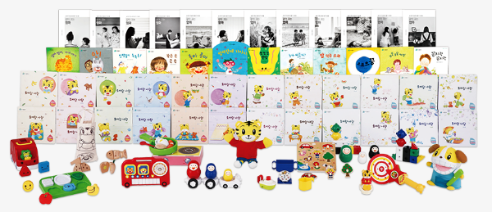



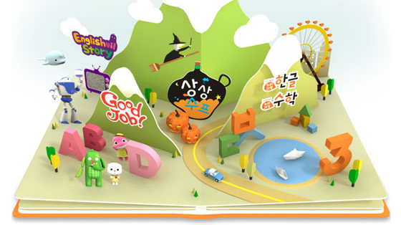
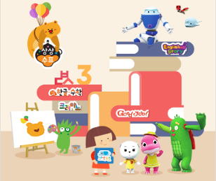


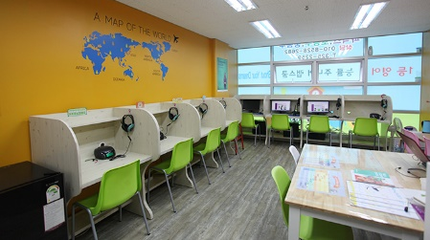
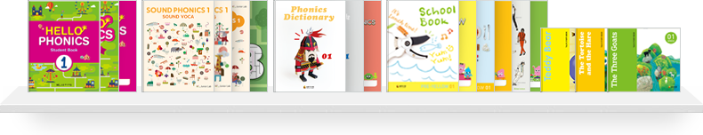
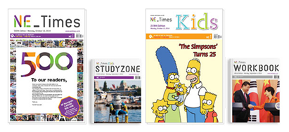



▶Business Area
Over 250 quality, original ELT books from the brand NE_Build & Grow, which specialized in ELT
Official importer of Oxford University Press ELT
ELT
A membership-based integrated development program for infants and toddlers to reinforce the social skills for children
i-Challenge
Textbook
Quality English, Chinese, and Japanese textbooks for middle and high school students
No.1 market share in public education in English
Business Area
Reference Book
Preschool Education
Educational programs and teacher training programs for preschools and kindergartens that connect to government-established preschool programs
More than 500 kinds of English study books, including numerous bestsellers
Math, Korean, and History reference books with effective learning methods
B2B Corporate Education
Franchise Program
English Newspaper for Education
English academy for elementary and middle school students that nurture self-directed learning habits
Expert education consulting services to corporations, universities, and public institutions
Weekly English newspapers for developing English-language and critical-thinking skills

Slide 5
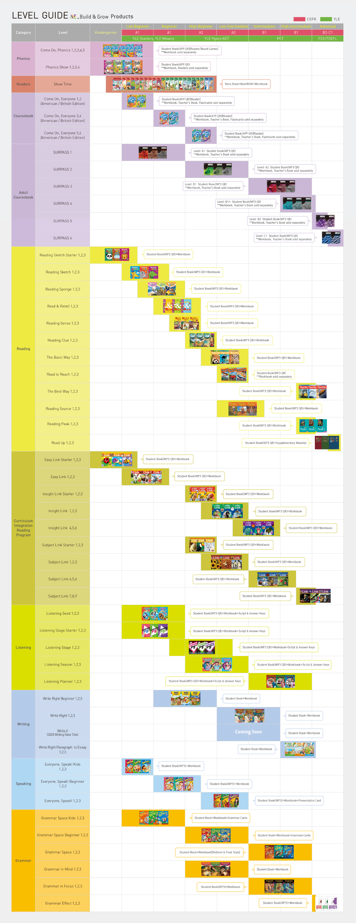
▶ELT Catalogue
Adult
Coursebook
Speaking
Writing
Curriculum
Intergration Reading
Listening
Grammar
Elementary
Coursebok
Reading
Phonics
Readers
NE_Build & Grow

Slide 6
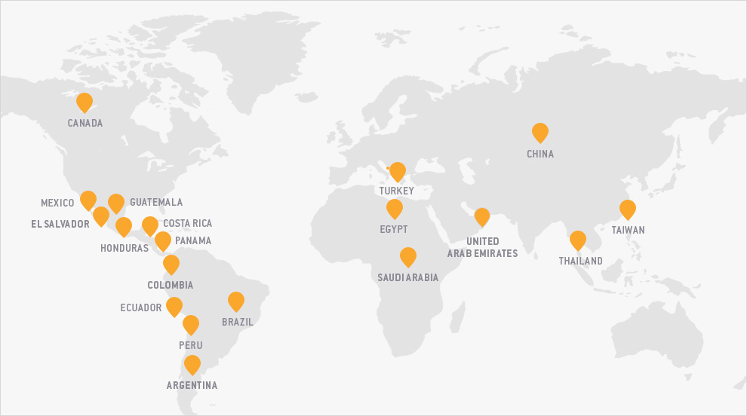
▶Exporting ELT content
to more than 30 countries area
including Asia, North and South America, and the Middle East.
Notes:
Where we go

Slide 7
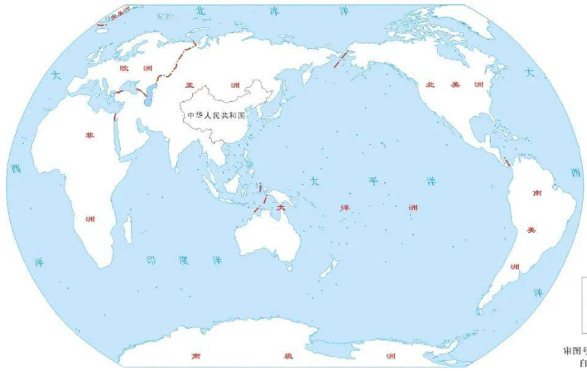
to more than 30 countries area
including Asia, North and South America, and the Middle East.

Slide 8
▶NE_Build & Grow Features
Online Teaching through NE_Build & Grow’s LMS

Slide 9
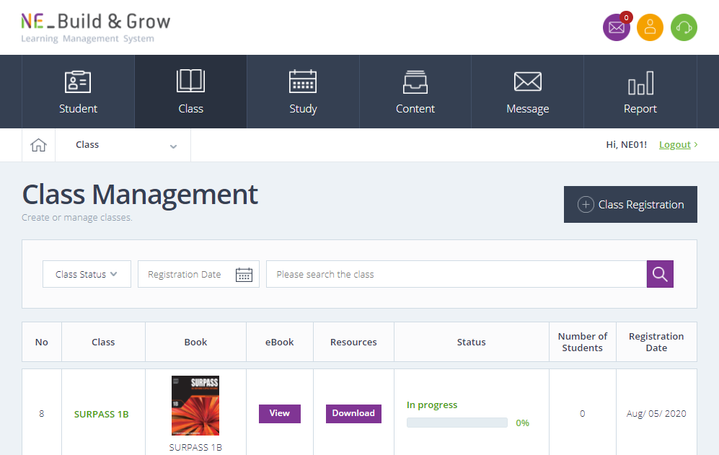



Teachers can access and share eBooks with students through
video conferencing programs or apps.
Teacher
Students

Slide 10
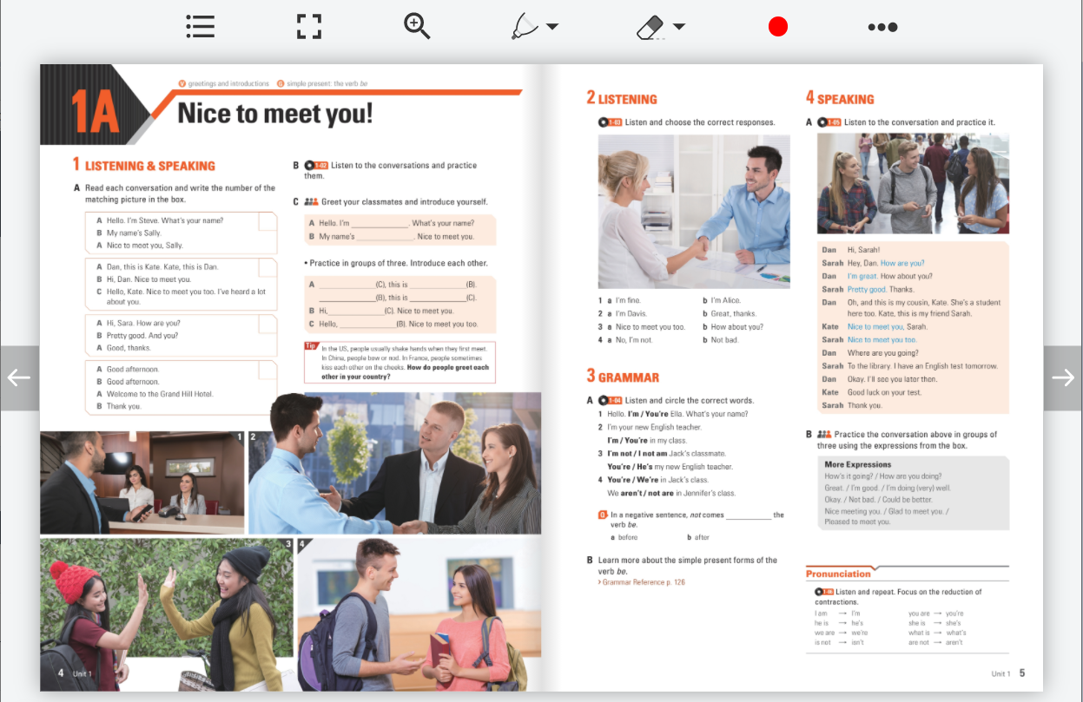

Teachers can access and share eBooks with students through
video conferencing programs or apps.
Teacher
Students

Slide 11
Teachers can download and use supplementary resources such as
Midterm/Final tests, Lesson plans, Teacher’s Guides, etc.
Teacher
Students

Slide 12
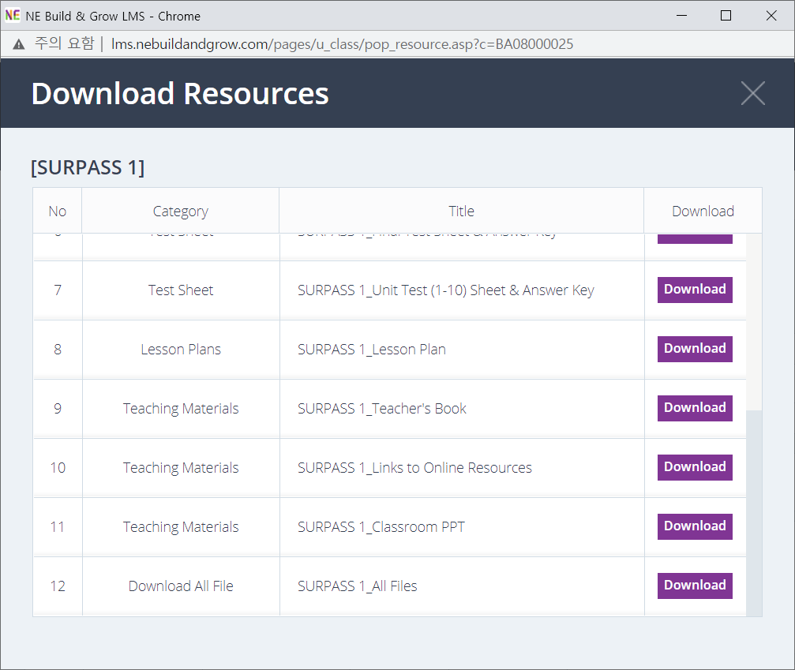
Teachers can download and use supplementary resources such as
Midterm/Final tests, Lesson plans, Teacher’s Guides, etc.
Teacher
Students

Slide 13
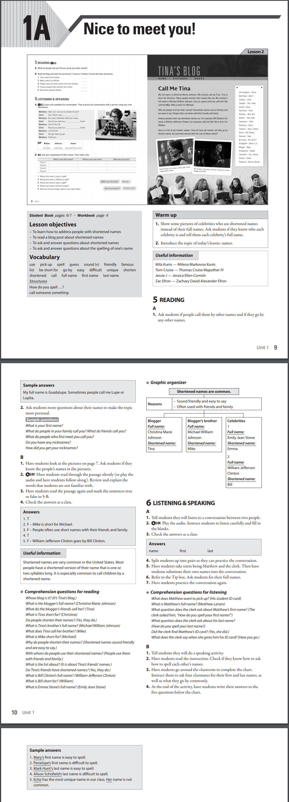
Teachers can download and use supplementary resources such as
Midterm/Final tests, Lesson plans, Teacher’s Guides, etc.
Teacher
Students

Slide 14
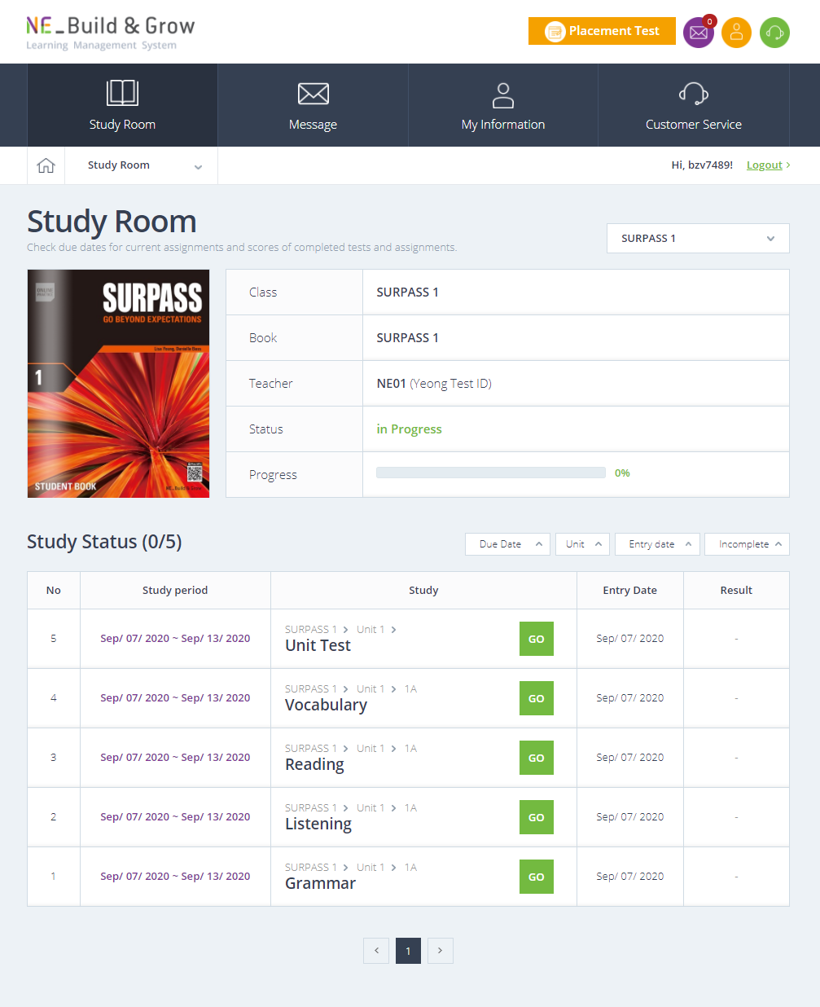
Teachers can assign additional book activities and unit tests to students to track their progress.
Teacher
Students

Slide 15
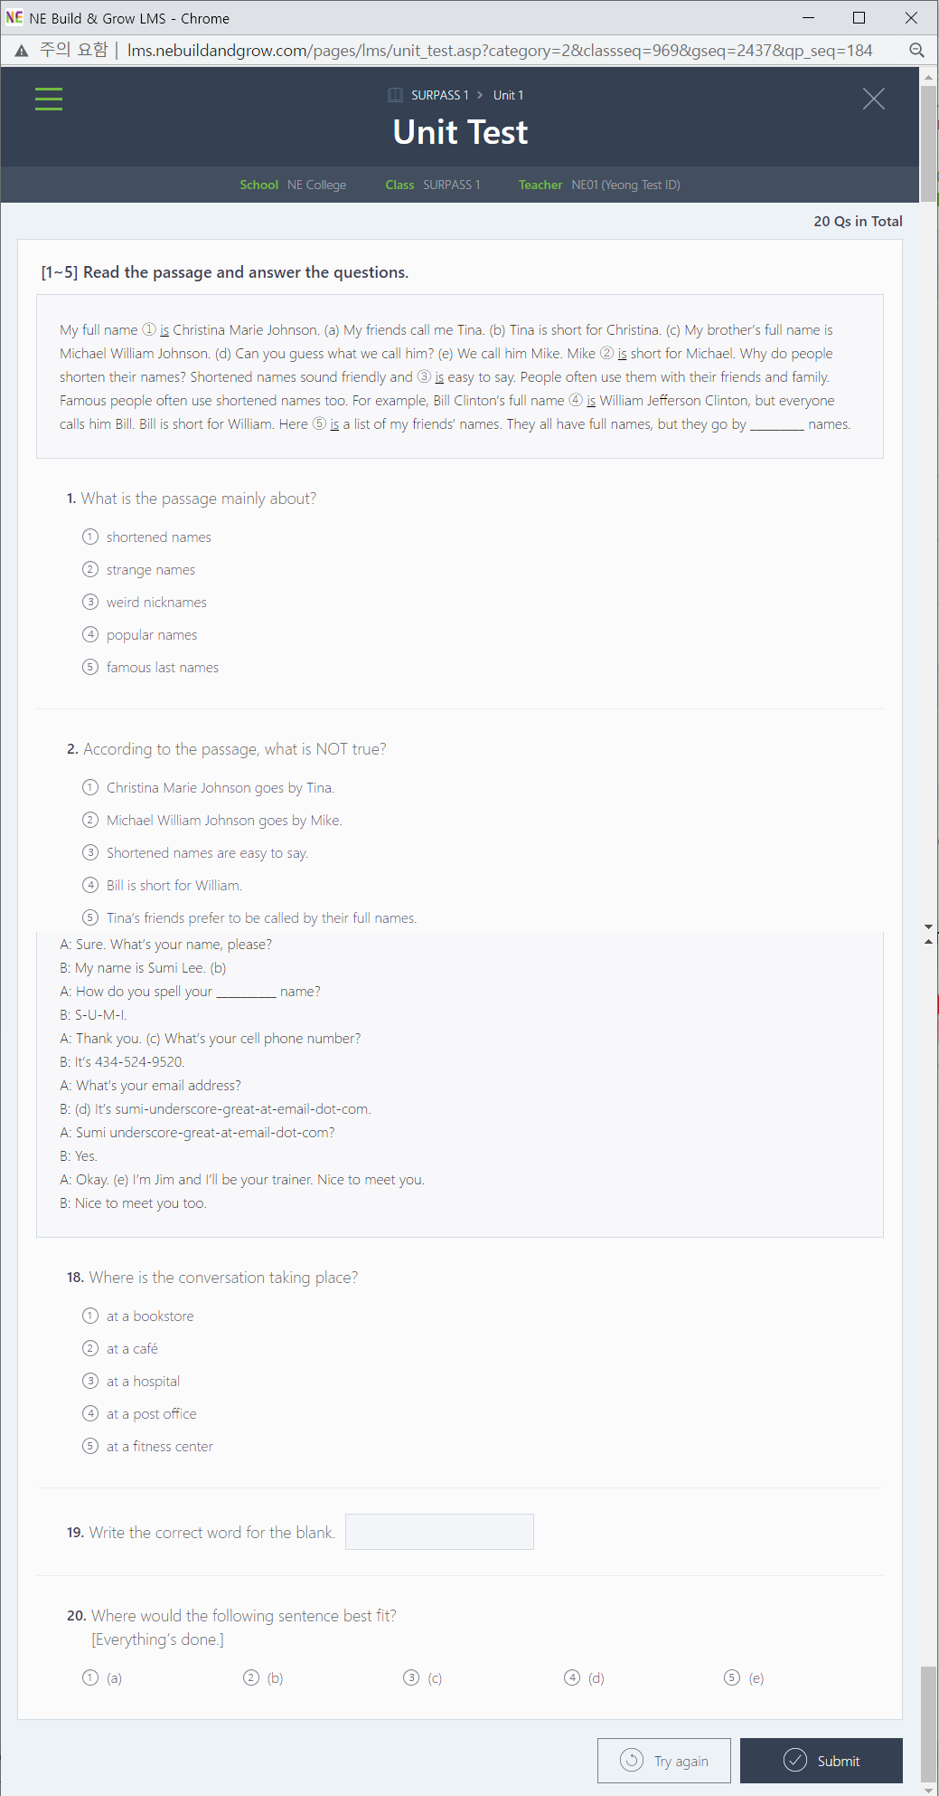
Teachers can assign additional book activities and unit tests to students to track their progress.
Teacher
Students

Slide 16
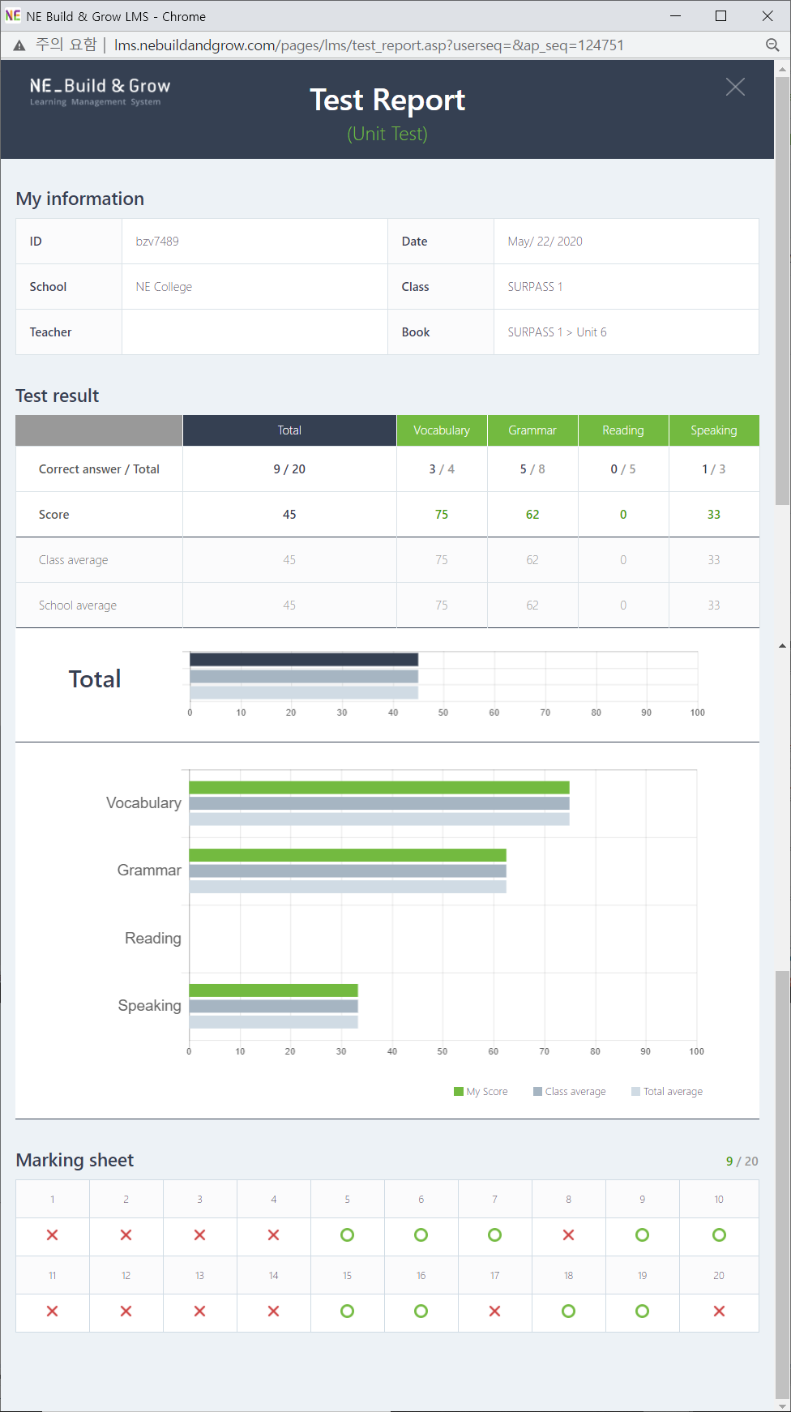
Teachers can assign additional book activities and unit tests to students to track their progress.
Teacher
Students

Slide 17

Students can use mobile applications with flashcards and chant/song/dialogue videos in order to review and practice by themselves.
Students

Slide 18
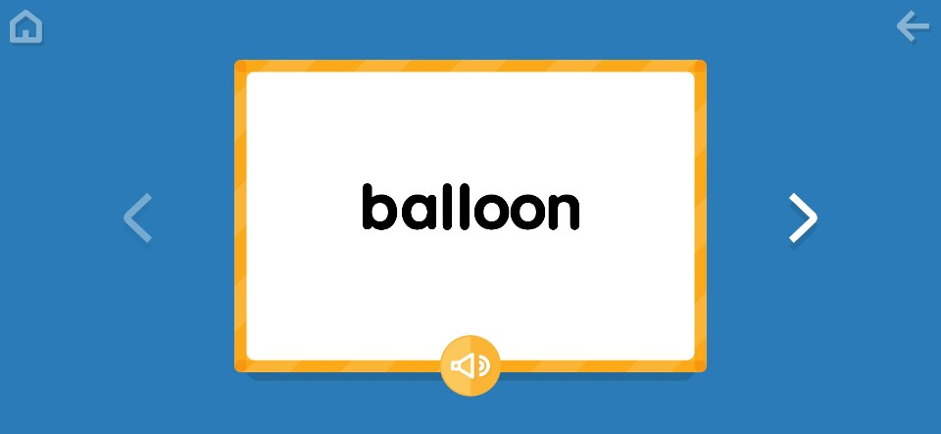
Students can use mobile applications with flashcards and chant/song/dialogue videos in order to review and practice by themselves.
Students

Slide 19

Students can use mobile applications with flashcards and chant/song/dialogue videos in order to review and practice by themselves.
Students

Slide 20
Teacher Training
NE_Build & Grow’s academic consultant and chief ELT editor
provide online and offline teacher training seminars.

Slide 21
Teacher Training
Open seminars for all teachers from a country or region or
customized and closed seminars for one particular school by request

Slide 22
Teacher Training
Topics range from theoretical/pedagogical to commercial.

Slide 23
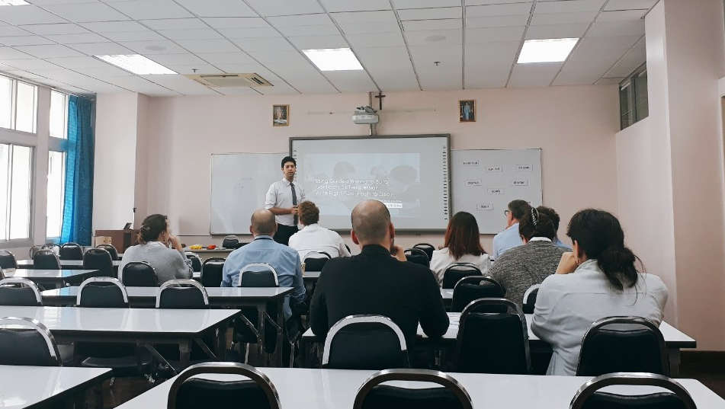
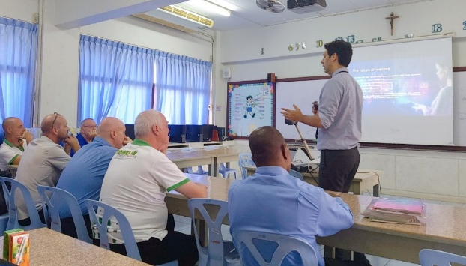
School Visit Teacher Training

Slide 24
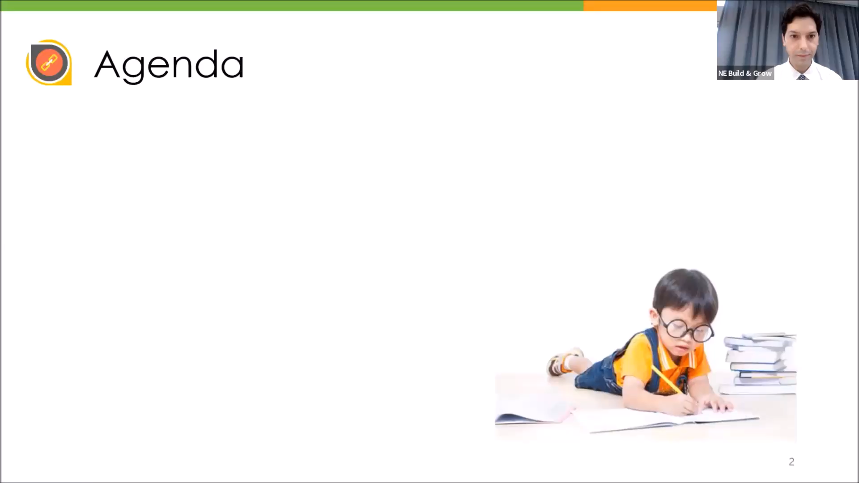
Webinar

Slide 25
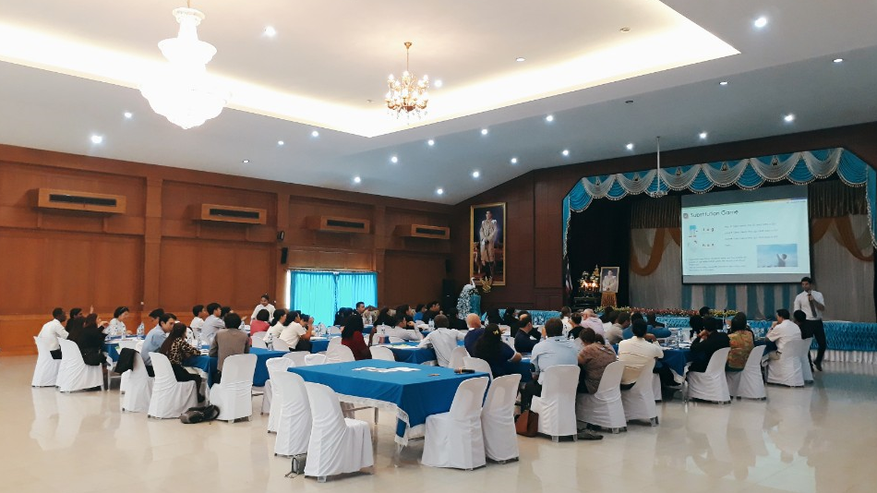
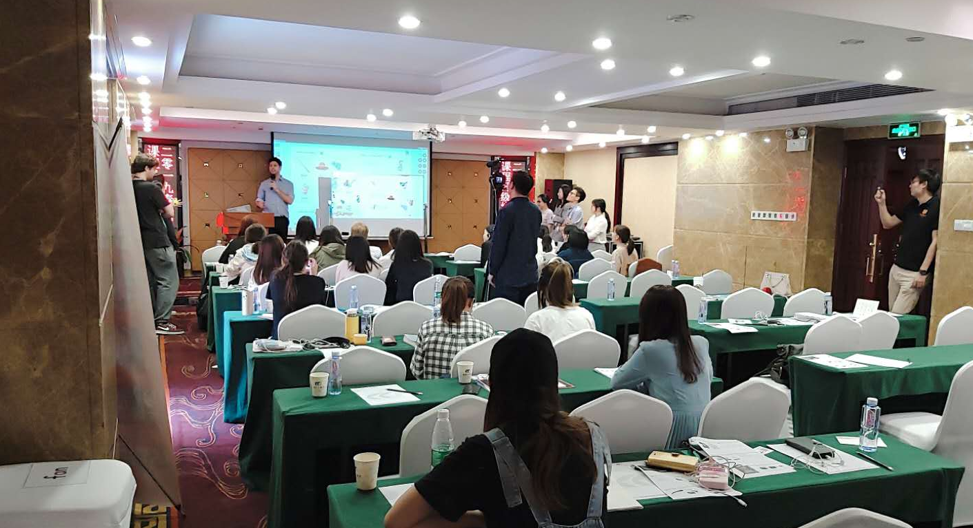
NE_Build & Grow Day / Regional Roadshow

Slide 26
Annual In-Person Business Meeting
  & Sales Rep Training
NE_Build & Grow sales managers and academic consultants
make annual visits to partner/distributor’s region.

Slide 27
Annual In-Person Business Meeting
  & Sales Rep Training
We have in-person meetings in order to discuss
market conditions, sales figures, marketing, new releases etc.

Slide 28
Annual In-Person Business Meeting
  & Sales Rep Training
and provide customized training sessions
for regional sales reps on demand.

Slide 29
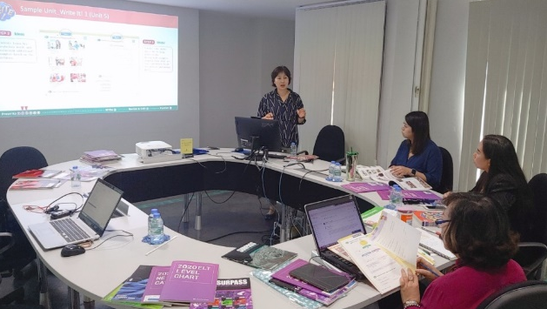
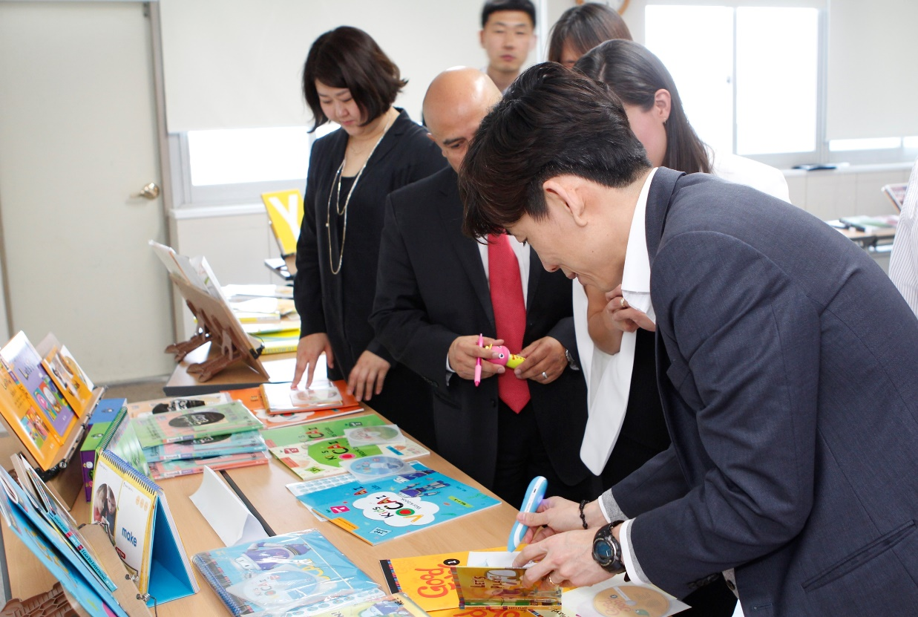
Sales rep training
Sales Rep Training

Slide 30
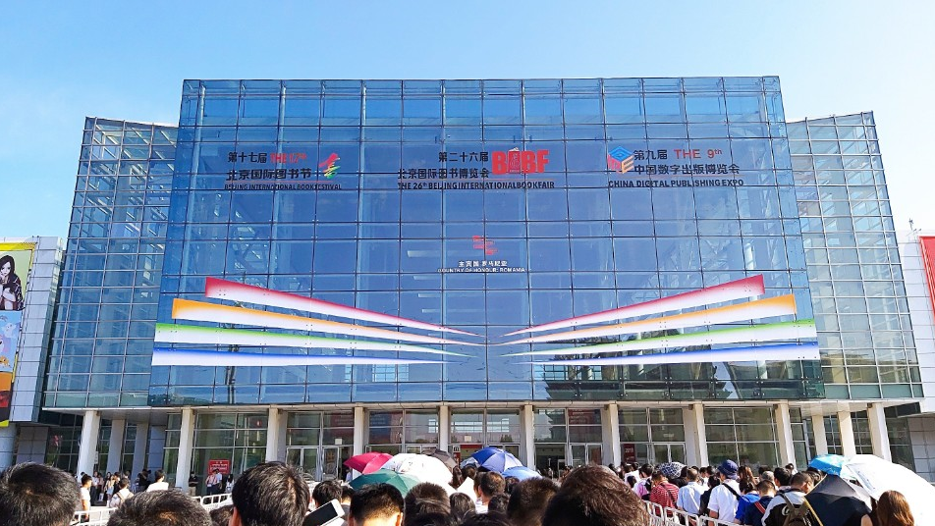
Book Fair / TESOL / Conference Participation
Beijing Book Fair

Slide 31
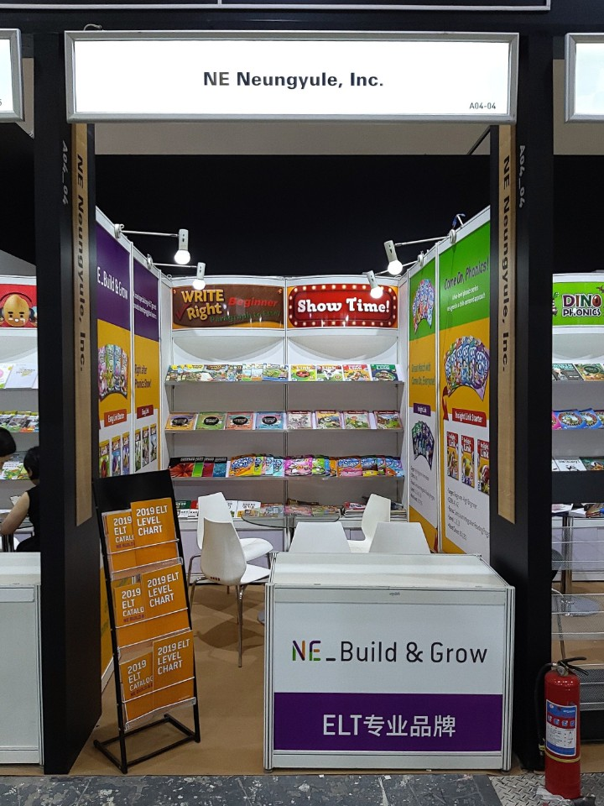
Book Fair / TESOL / Conference Participation
Beijing Book Fair

Slide 32
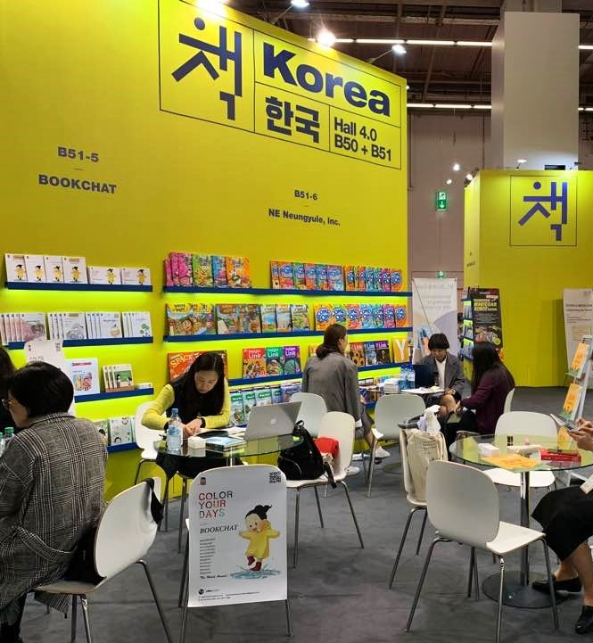
Book Fair / TESOL / Conference Participation
Frankfurt Book Fair

Slide 33
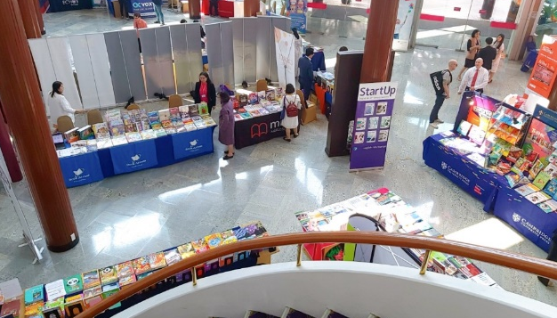
Book Fair / TESOL / Conference Participation
ThaiTESOL

Slide 34
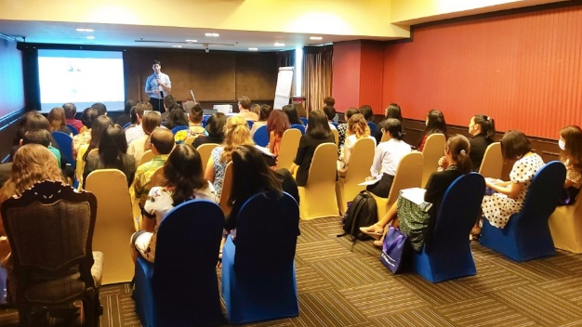
Book Fair / TESOL / Conference Participation
ThaiTESOL

Slide 35
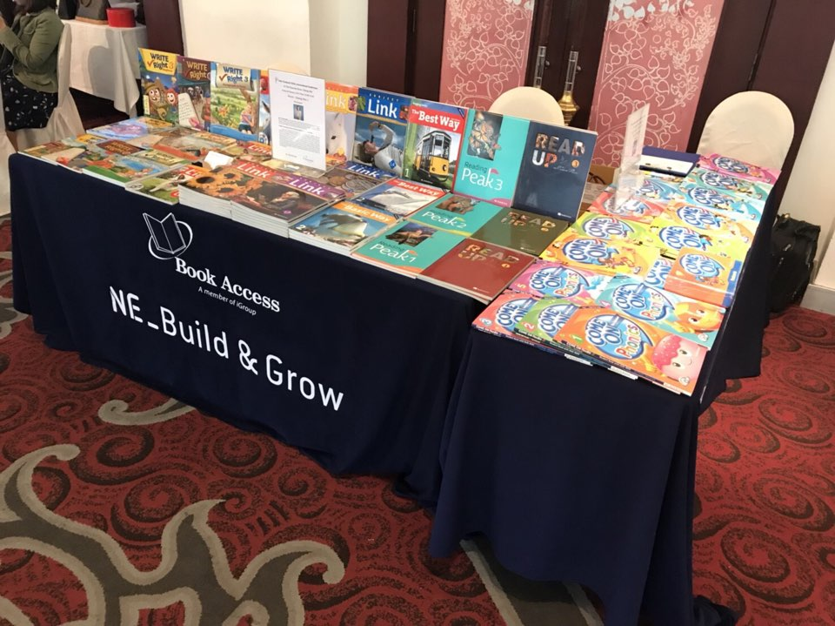
Book Fair / TESOL / Conference Participation
ThaiTESOL

Slide 36
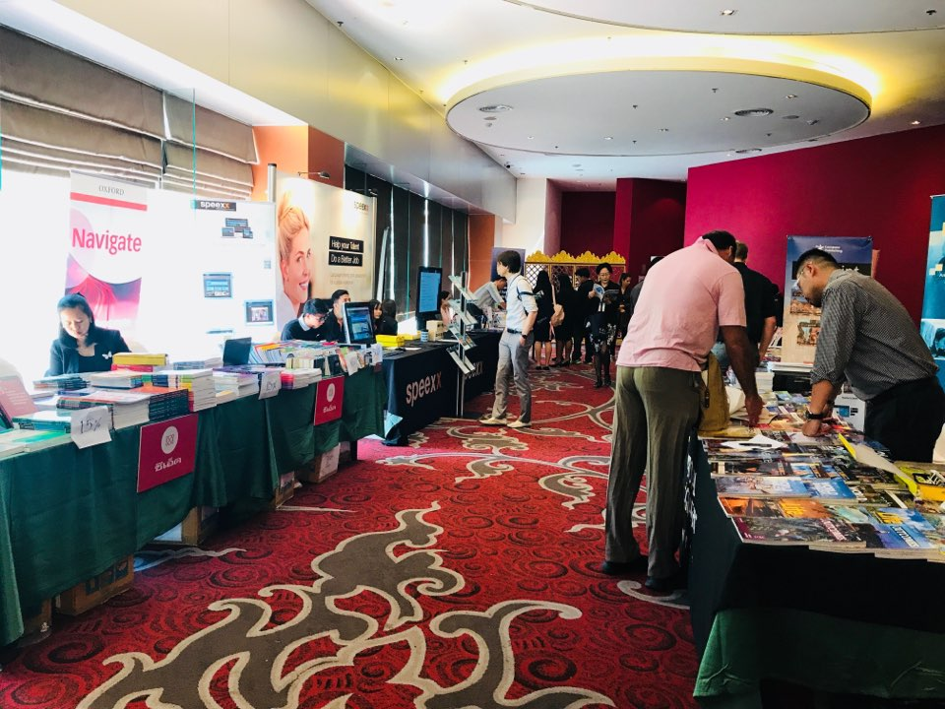
Book Fair / TESOL / Conference Participation
ThaiTESOL

Slide 37
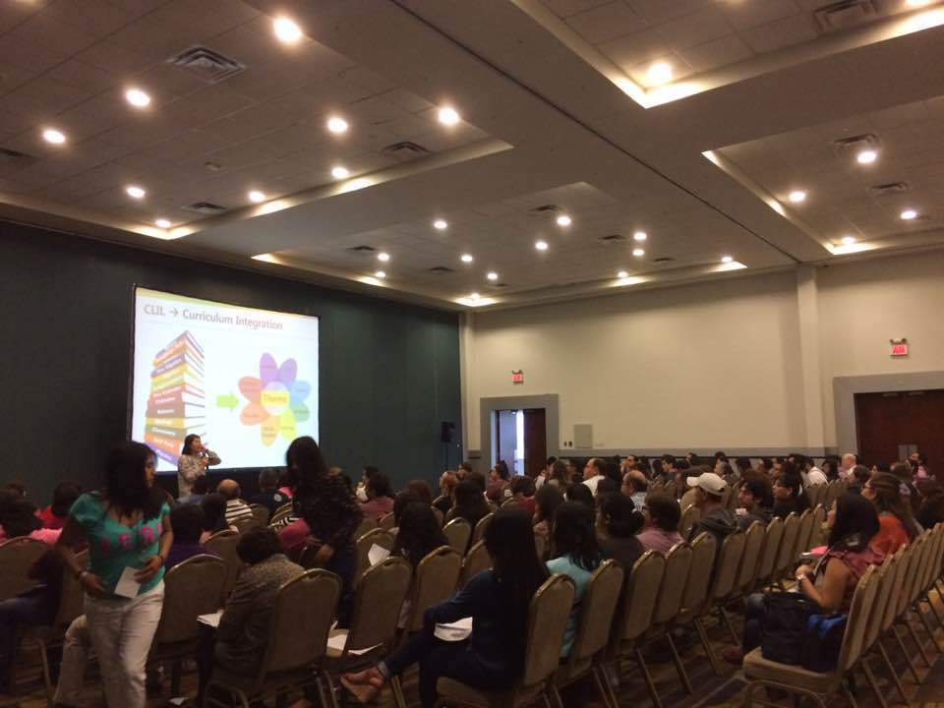
Book Fair / TESOL / Conference Participation
MEXTESOL

Slide 38
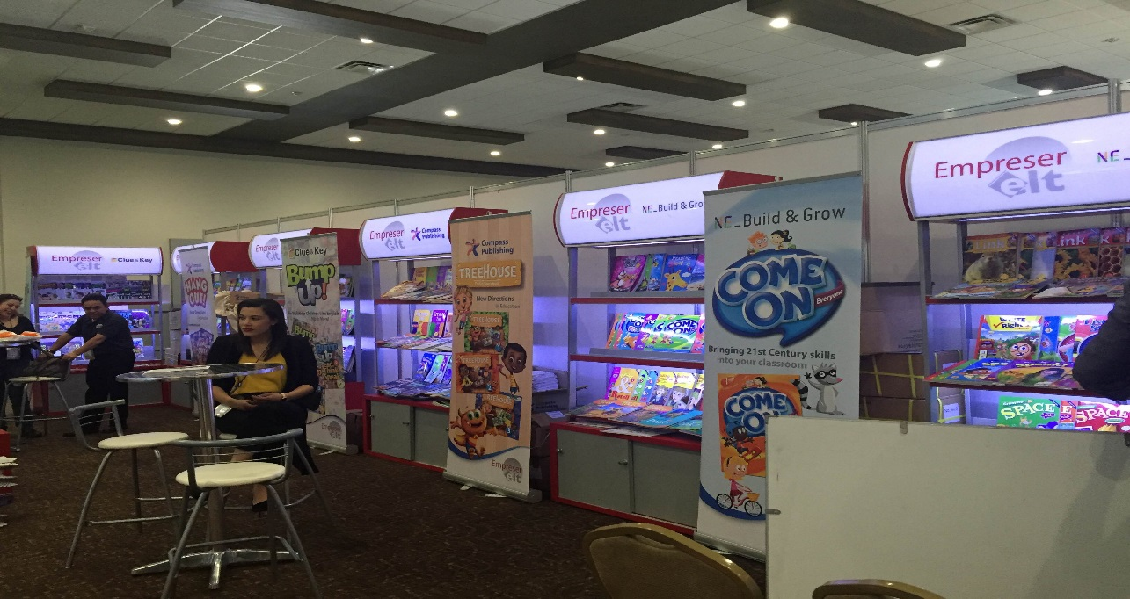
Book Fair / TESOL / Conference Participation
MEXTESOL

Slide 39
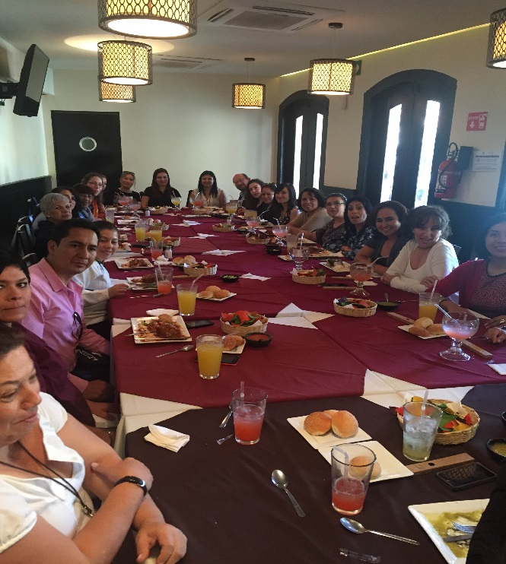
Book Fair / TESOL / Conference Participation
MEXTESOL

Slide 40
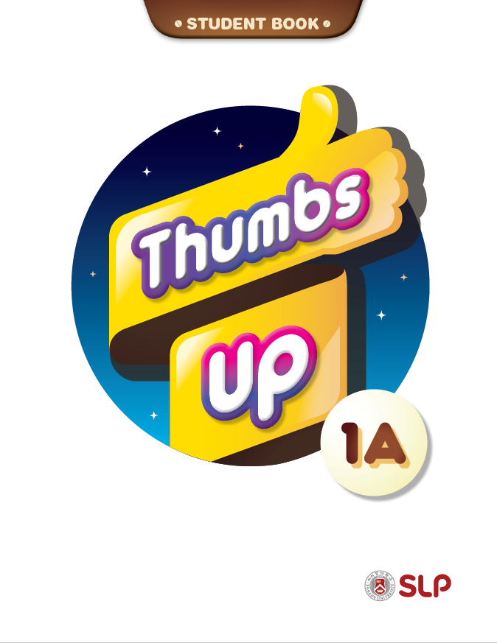

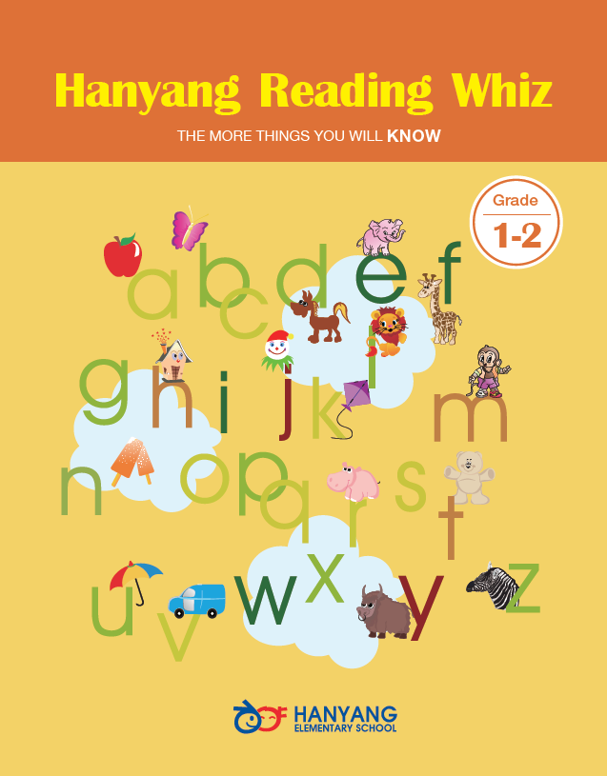
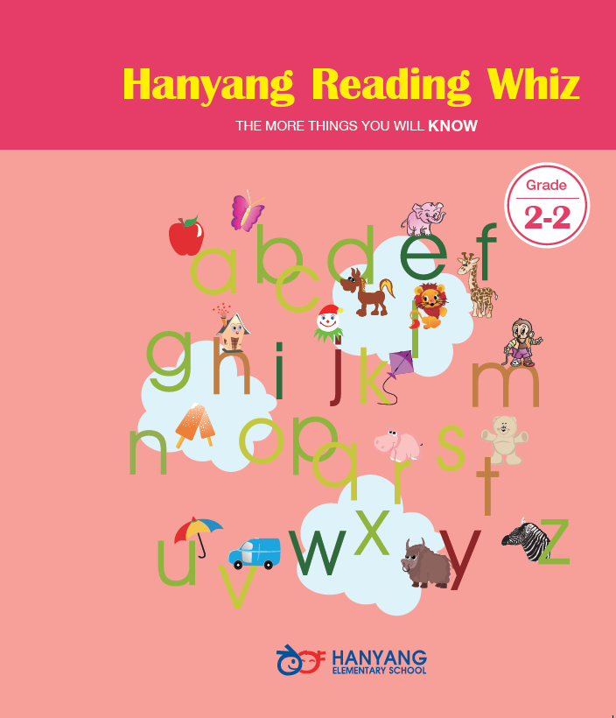
Customized Book Cover with the School’s Name and Logo

Slide 41
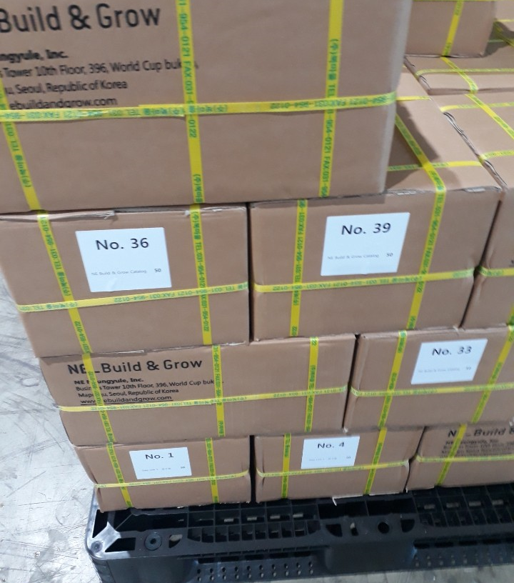
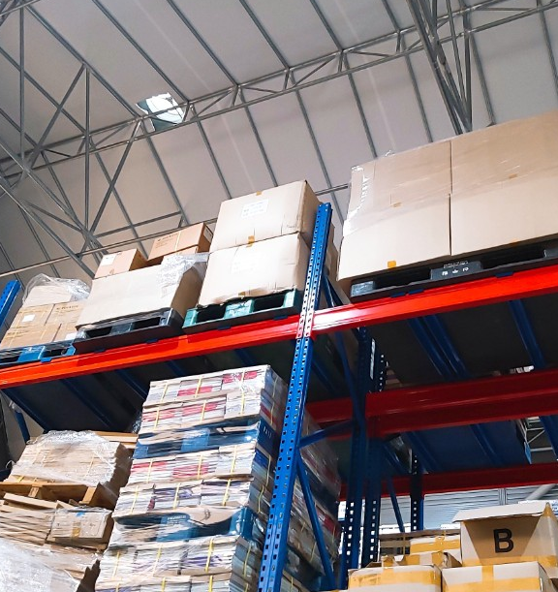
Discounted Price for Bulk Order

Slide 42

Thank you for your time.
We look forward to further discussing the possibility of building a strong, lasting partnership together.

